Slide 1
Computer Graphics and Multimedia Systems SCS1302
Unit 2

Slide 2
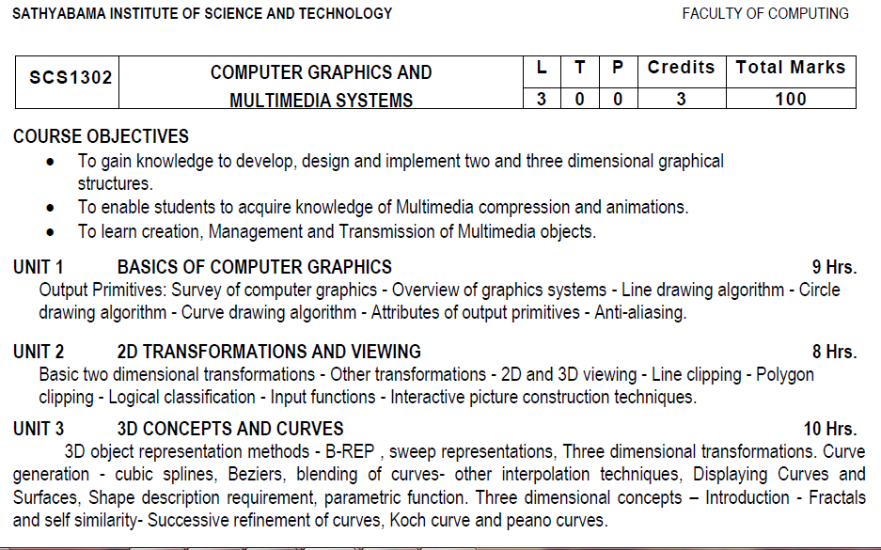
Syllabus

Slide 3
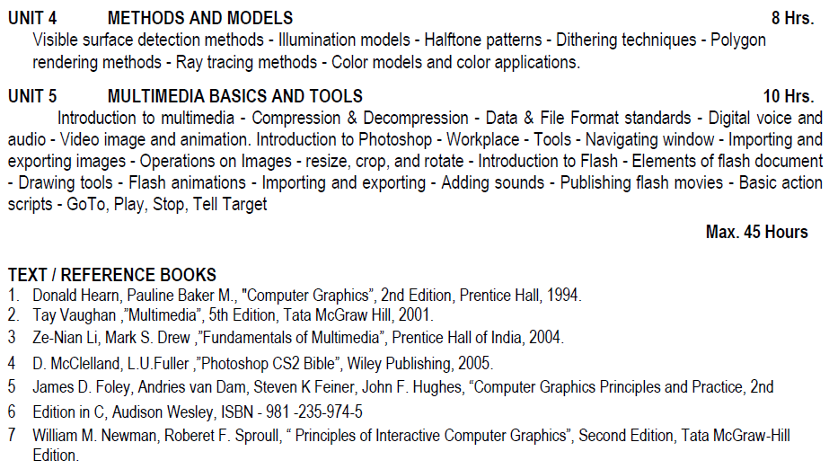
Syllabus

Slide 4
Course Objective(CO)
CO1: Construct lines and circles for the given input.
CO2: Apply 2D transformation techniques to transform the shapes to fit them as per the picture definition.
CO3: Construct splines, curves and perform 3D transformations
CO4: Apply colour and transformation techniques for various applications.
CO5: Analyse the fundamentals of animation, virtual reality, and underlying technologies.
CO6: Develop photo shop applications

Slide 5
2D Transformation in Computer Graphics
In Computer graphics, Transformation is a process of modifying and re-positioning the existing graphics.
2D Transformations take place in a two dimensional plane.
Transformations are helpful in changing the position, size, orientation, shape etc of the object.

Slide 6
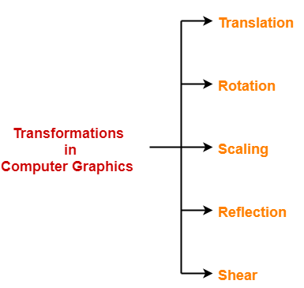
Transformation Techniques
In computer graphics, various transformation techniques are:

Slide 7
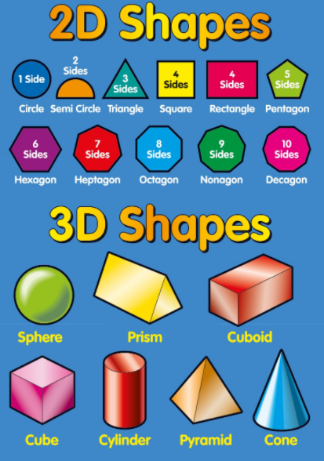
2D vs 3D

Slide 8
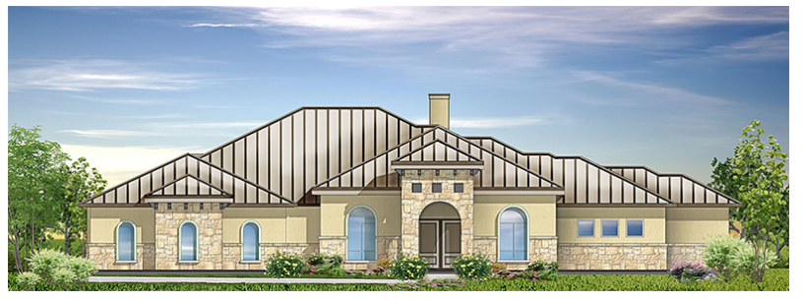
2D

Slide 9
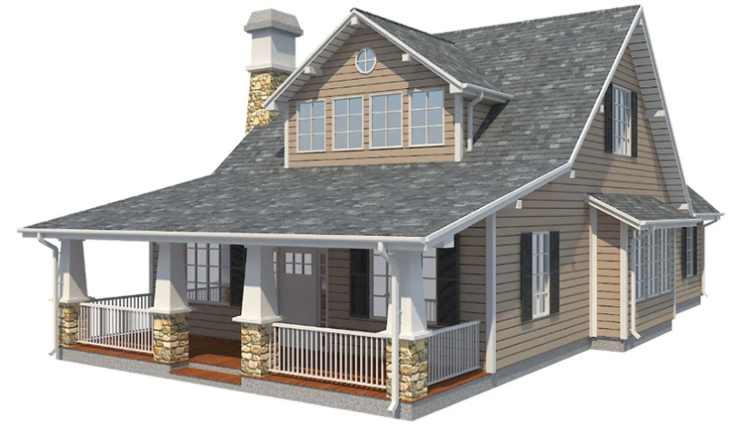
3D

Slide 10
2-Dimensional Transformations
The Basic Transformations:
Translation
Scaling
Rotation
Other Transformations:
Reflection
Shearing

Slide 11
Translation
Displacement of an object in a given distance and direction from its original position.
Rigid body transformation that moves object without deformation
Initial Position point P (x, y)
The new point P’ (x’, y’)
where x’ = x + tx , y’ = y + ty , tx and ty is the displacement in x and y respectively.

Slide 12
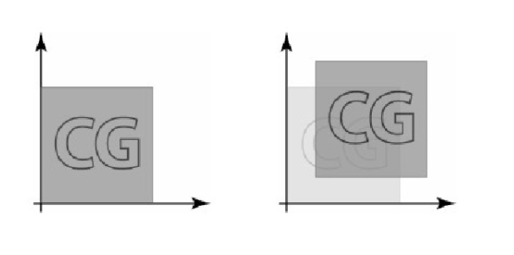
Translation

Slide 13
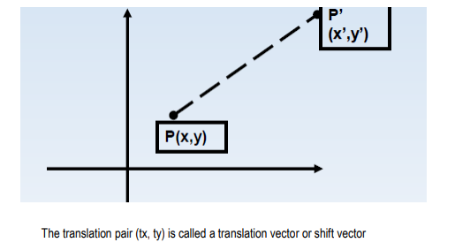
Translation

Slide 14
Example: Translation
Assume you are given a point at (x,y)=(2,1). Where will the point be if you move it 3 units to the right and 1 unit up?
Ans: (x',y') = (5,2).
How was this obtained? - (x',y') = (x+3,y+1)

Slide 15
Translation
A translation can also be represented by a pair of numbers, t=(tx,ty) where tx is the change in the x-coordinate and ty is the change in y coordinate. To translate the point p by t, we simply add to obtain the new (translated) point.

Slide 16
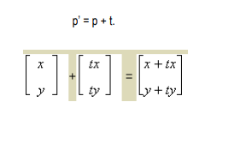
Translation

Slide 17
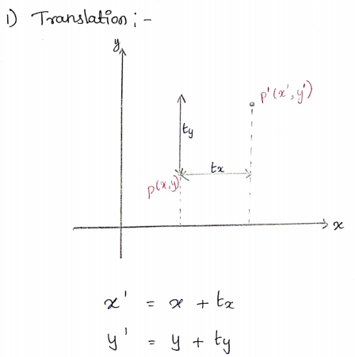

Slide 18
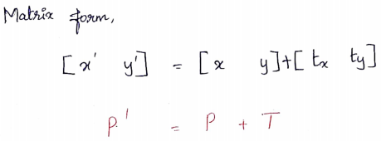
Translation

Slide 19
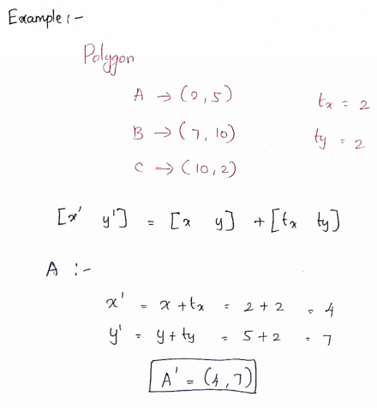
Example: Translation

Slide 20
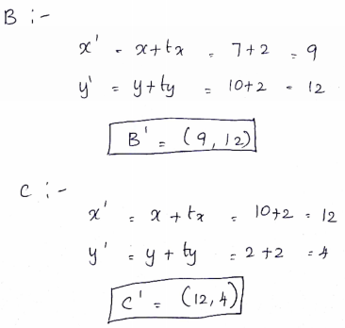
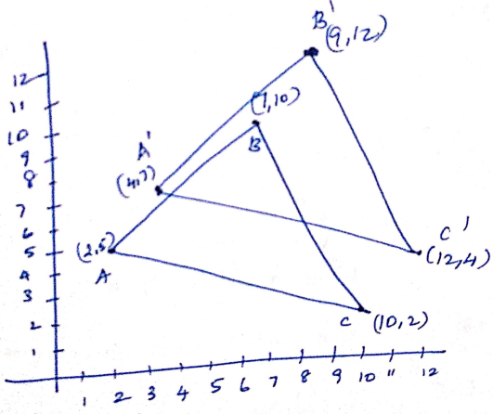
Example: Translation

Slide 21
Rotation
Rotation is applied to an object by repositioning it along a circular path in the xy plane.
To generate a rotation, we specify
Rotation angle θ
Pivot point ( xr , yr)
Positive values of θ for counterclockwise rotation. Negative values of θ for clockwise rotation.

Slide 22
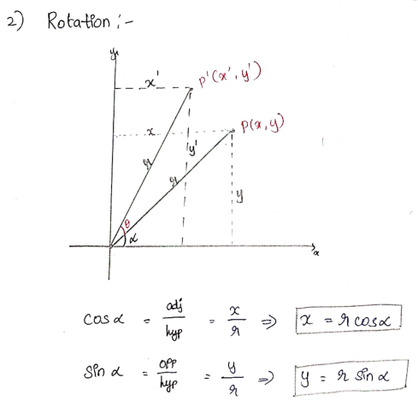
Rotation

Slide 23
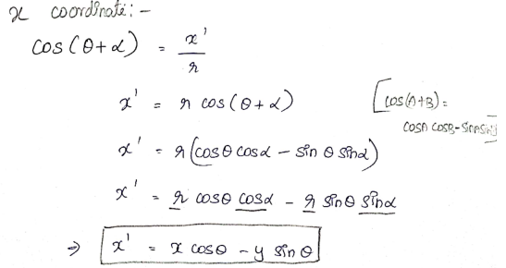
Rotation

Slide 24
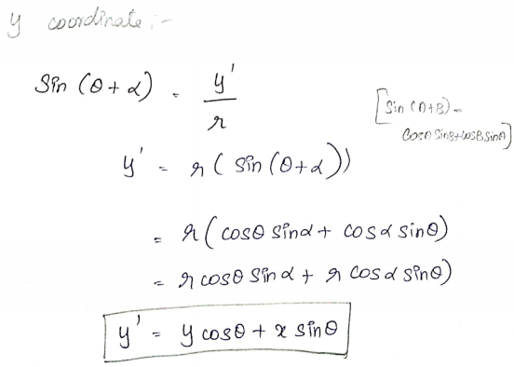
Rotation

Slide 25
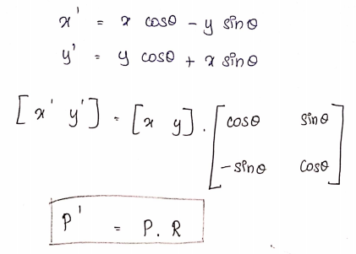
Rotation

Slide 26
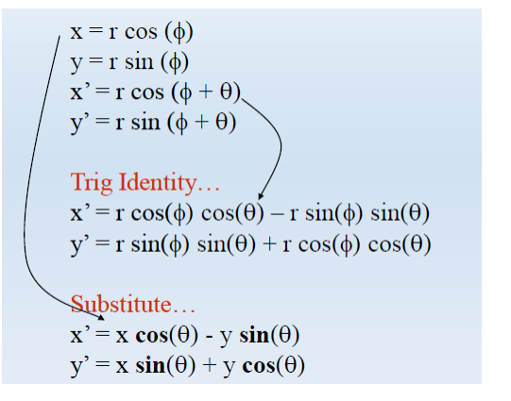
Rotation

Slide 27
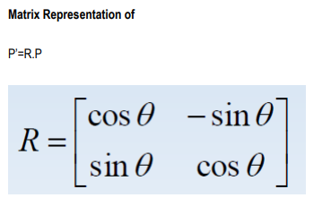
Rotation

Slide 28
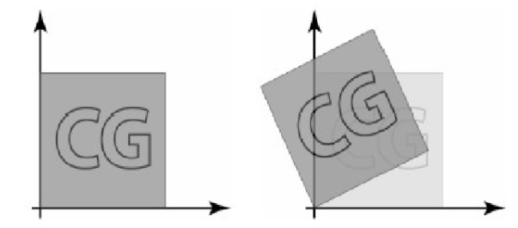
Rotation

Slide 29
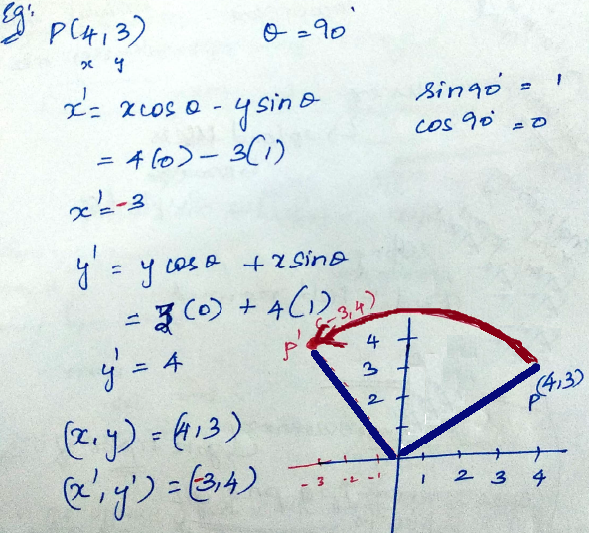
Example: Rotation

Slide 30
Scaling
Scaling alters the size of an object.
Operation can be carried out by multiplying each of its components by a scalar
Uniform scaling means this scalar is the same for all components
Non-uniform scaling: different scalars per component
x’ = x* sx
y’ = y * sy

Slide 31
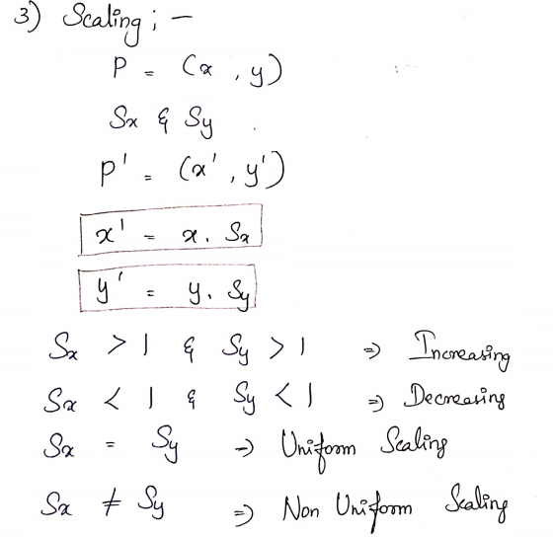
Scaling

Slide 32
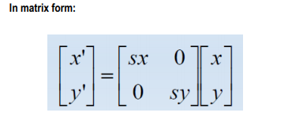
Scaling

Slide 33
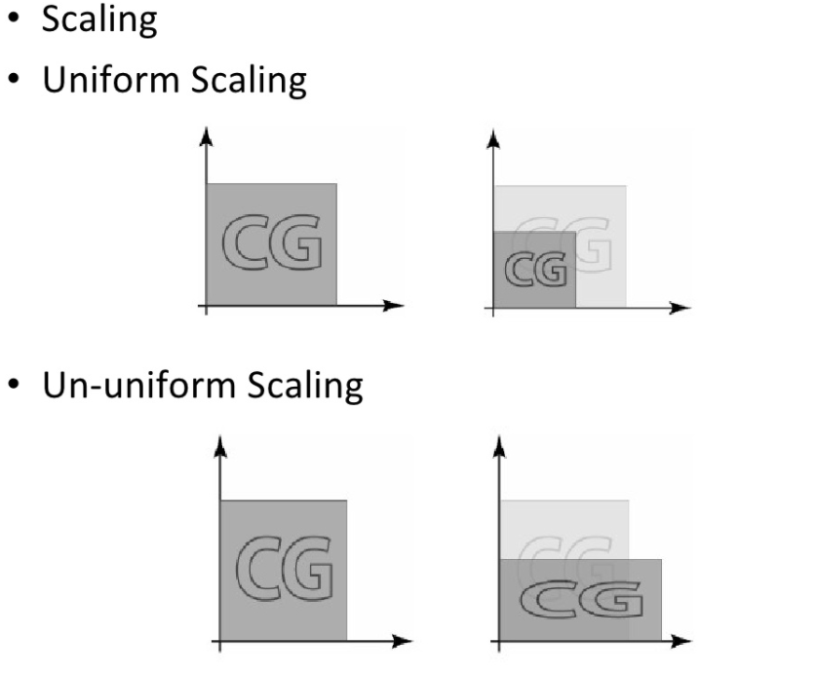

Slide 34
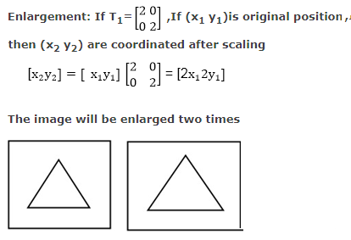
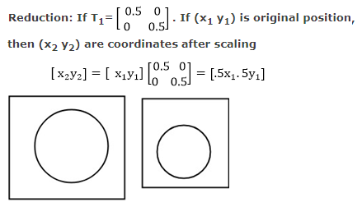
Example: Scaling

Slide 35
Reflection
A reflection is a transformation that produces a mirror image of an object generated relative to an axis of reflection
Reflection along x axis
Reflection along y axis
Reflection relative to an axis perpendicular to the xy plane and passing through the coordinate origin
Reflection of an object relative to an axis perpendicular to the xy plane and passing through point P
Reflection of an object with respect to the line y=x.

Slide 36
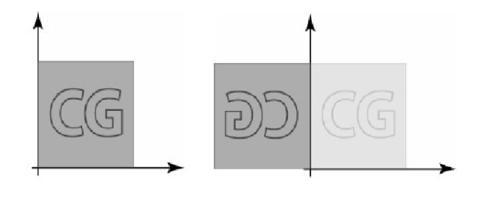
Reflection

Slide 37
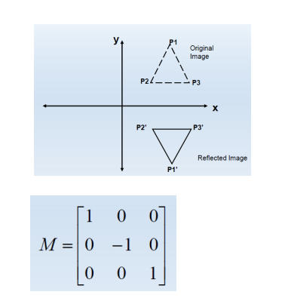
Reflection about x-axis:

Slide 38
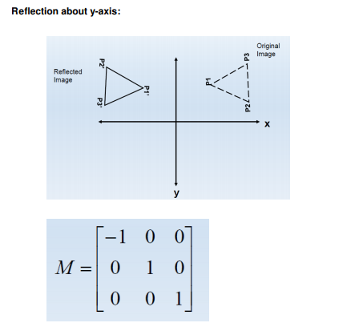
Reflection about y-axis:

Slide 39
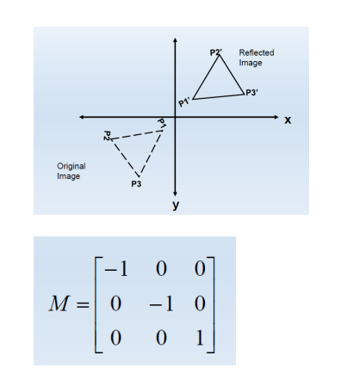
Reflection relative to an axis perpendicular to the xy plane and passing through the coordinate origin:

Slide 40
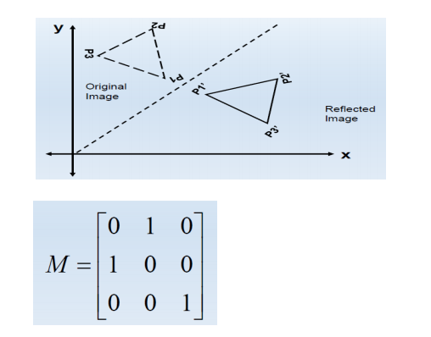
Reflection of an object with respect to the line y=x

Slide 41
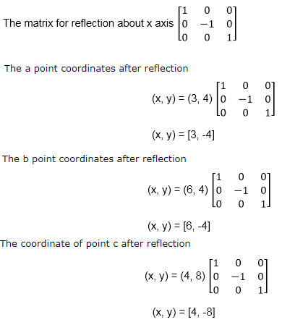
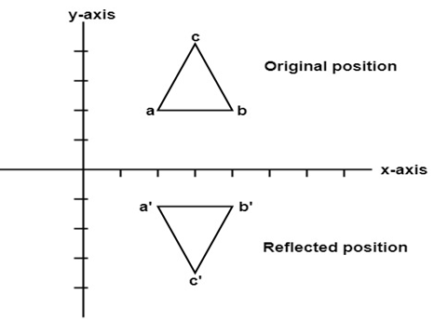
Example: Reflection
A triangle ABC is given. The coordinates of A, B, C are given as
A (3 4) B (6 4) C (4 8)
Find reflected position of triangle i.e., to the x-axis.

Slide 42
Example: Reflection
a (3, 4) becomes a` (3, -4) b (6, 4) becomes b` (6, -4) c (4, 8) becomes c` (4, -8)

Slide 43
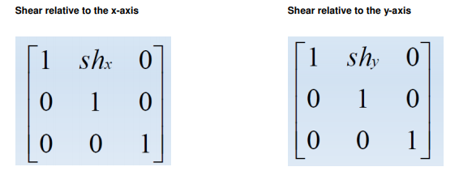
Shearing
A transformation that distorts the shape of an object such that the transformed object appears as if the object were composed of internal layers that had been caused to slide over each other.

Slide 44
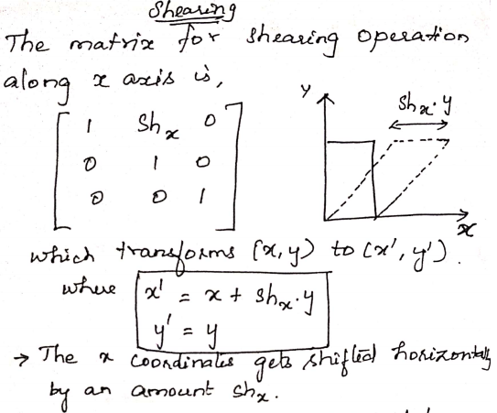
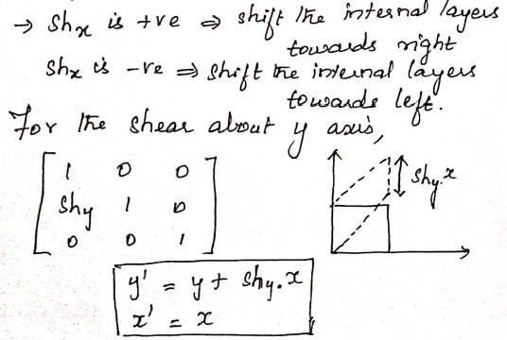
Shearing

Slide 45
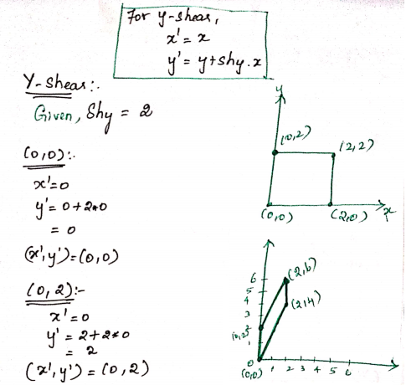
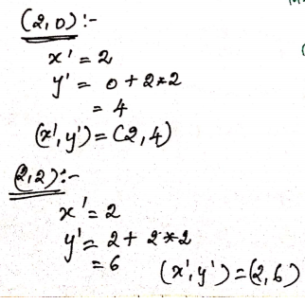
Example – Y_Shearing

Slide 46
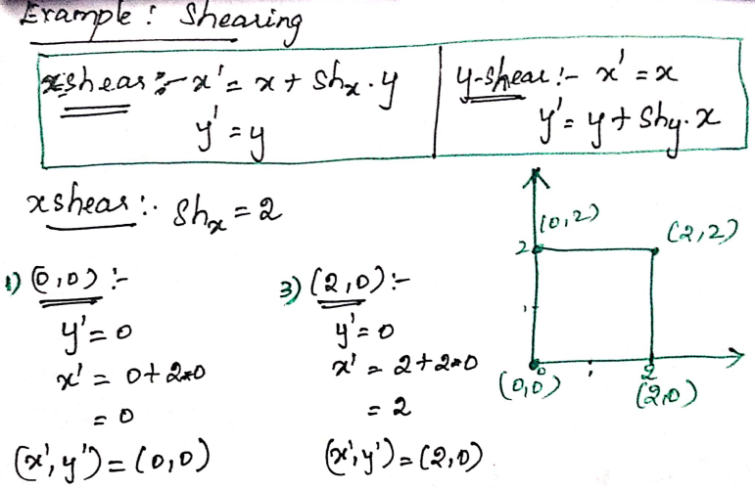
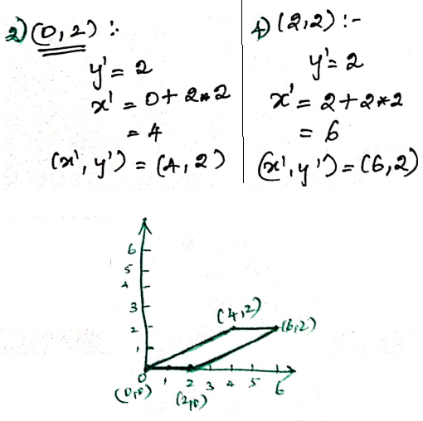
Example – X_Shearing

Slide 47
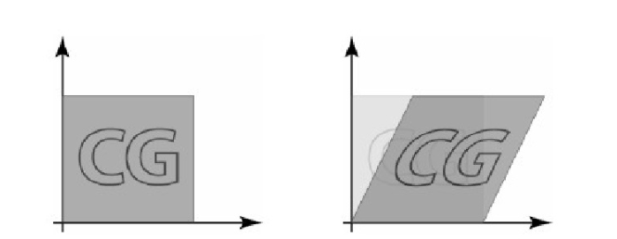
Shearing

Slide 48
Homogeneous Coordinates
Expressing positions in homogeneous Coordinates allows us to represent all geometric transformation equations as matrix multiplications.
Coordinates are represented with three-element column vectors, and transformation operations are written as 3 by 3 matrices.

Slide 49
Homogeneous Coordinates
To combine these three transformations into a single transformation, homogeneous coordinates are used. In homogeneous coordinate system, two-dimensional coordinate positions (x, y) are represented by triple-coordinates.
Homogeneous coordinates are generally used in design and construction applications. Here we perform translations, rotations, scaling to fit the picture into proper position.
Example of representing coordinates into a homogeneous coordinate system: For two-dimensional geometric transformation, we can choose homogeneous parameter h to any non-zero value. For our convenience take it as one. Each two-dimensional position is then represented with homogeneous coordinates (x, y, 1).

Slide 50
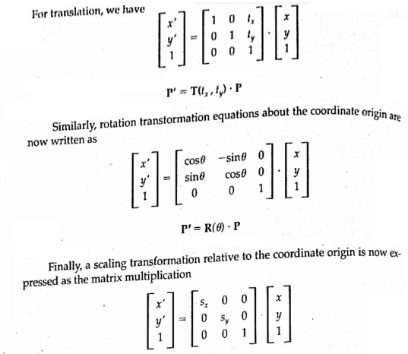
Homogeneous Coordinate representation of 2D

Slide 51
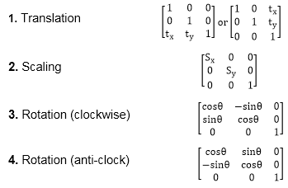
Matrix Representation for two-dimensional transformation in homogeneous coordinates

Slide 52
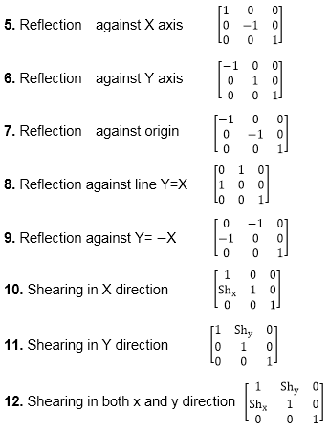

Slide 53
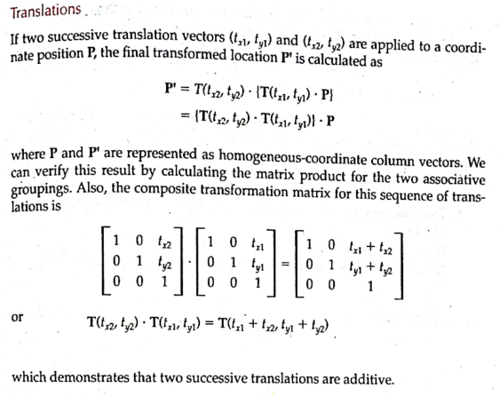
Composite Transformations

Slide 54
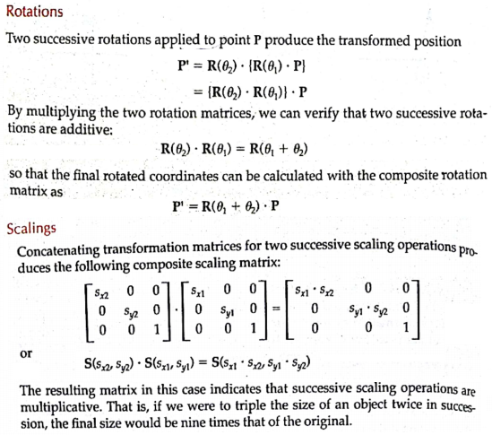
Composite Transformations

Slide 55
Thank you

